Slide 1
Ecology without Class Struggle is Gardening
Chico Mendes
Class struggle without ecology is suicide Nora Räthzel, Umeå University, Sweden

Slide 2
1. Complicating the North-South Relation

Slide 3
Global North
Global South

Slide 4
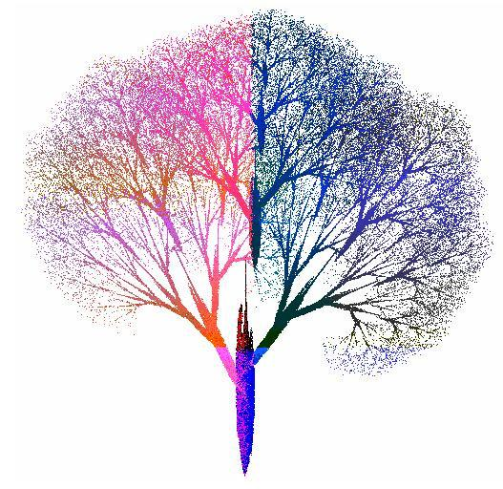
Fractals: Self-similarity along different levels

Slide 5
Global North Capitalists, Politicians, …
Global South Capitalists, Politicians, Landowners, ….
Global South Workers (relatively safe working conditions)
Global South (precarious, informal workers)
Global North Workers (relatively safe working conditions, mostly white men)
Global North workers (precarious, mostly female and migrant workers)
Global South subsistence workers, indigenous populations
Ever greater numbers of workers worldwide maintain direct economic contacts with one another.

Slide 6
2. Globalisation is not Homogenisation
Homogenisation is clear in part from the continuously increasing share of employees in the world population.

Slide 7
But I mean why should we be called international if we don’t follow the same set as everywhere else…you started thinking, are we cheap labour? I mean are they coming to this country to exploit us now? … that sort of behaviour starts you thinking, what am I to you, a slave?
We went through this, you should stop this now, because workers are not going to take this anymore

Slide 8
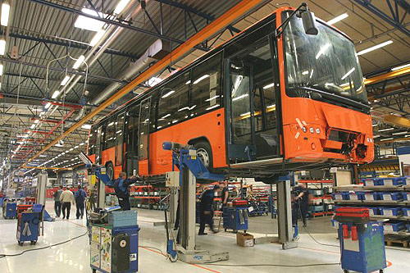
There is another work culture in Mexico. Looking at the Volvo values, the colleagues thought that what they are going to do, is to bring the European culture here. But they did not bring it, this European culture that takes care of people. There is a lot of insecurity here. There is work, but it’s not well paid. People are disappointed. As part of the values of Volvo they speak about the respect of the person. But people ask: Where is this respect? Why are we not paid?
The answer of the manager for corporate social responsibility

Slide 9
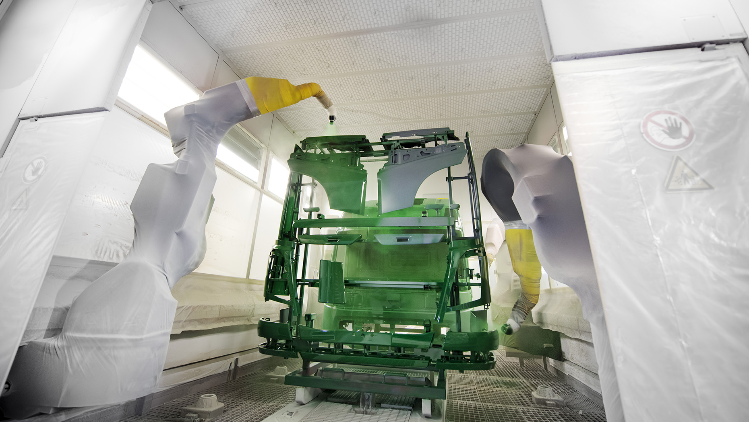
Man 1: But in the paint shop, the paintwork (…), they won’t do it here, they will take it outside.
Man 2 : It’s urgent work. You cannot wait.
Man 3: It’s an environmental problem. It’s a people’s health problem. And they won’t do – they will not bother about that.
Man 1: They won’t bother. So, in an open environment they are spraying.
Man 2: And also, they are not thinking of humans. For people who are working in a paint booth, they have to go every four months for medical check-up. But they will only do yearly ones.
Notes:
Tell the Indian story

Slide 10
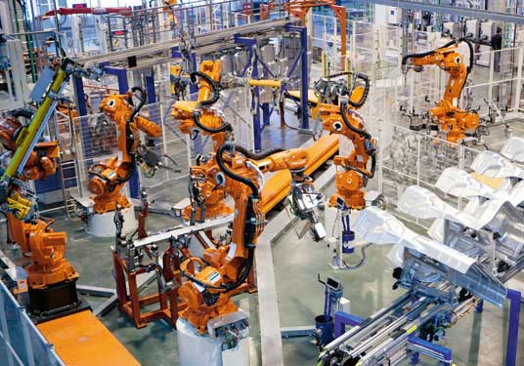
The lack of communication between workers in these different Volvo plants!
It is not often that one feels that now I have finished building this and now I am proud of this. Because there were many who felt that way when we worked in teams. You could feel kind of proud then, but now that has disappeared completely.

Slide 11
3. Integrating the nature-labour relationship

Slide 12
Jason w. Moore

Slide 13
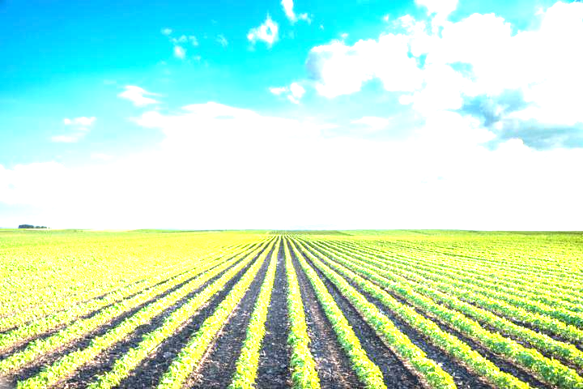
Global North Capitalists, Politicians, …
Global South Capitalists, Politicians, Landowners, ….
Global South Workers (relatively safe working conditions)
Global South (precarious, informal workers)
Global North Workers (relatively safe working conditions, mostly white men)
Global North workers (precarious, mostly female and migrant workers)
Global South subsistence workers, indigenous populations

